Slide 1
unstop’s
HR-Tech Innovation Challenge: AI-Powered Resume Screening
& Employee Engagement Analysis
Ashutosh Jaiswal
IIIT-NR
Api Endpoint: https://attrition-app.purpleplant-47c020aa.eastus.azurecontainerapps.io/predict

Slide 2



Why We Built This ?
Manual resume screening is slow and biased
Attrition costs companies time and money
Our solution:
NLP + AI to screen resumes
ML to predict employee attrition
AI-generated suggestions for HR actions

Slide 3
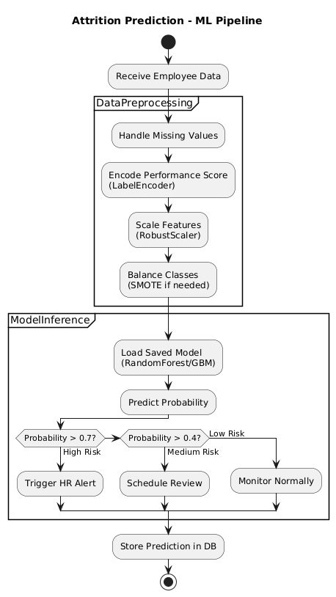
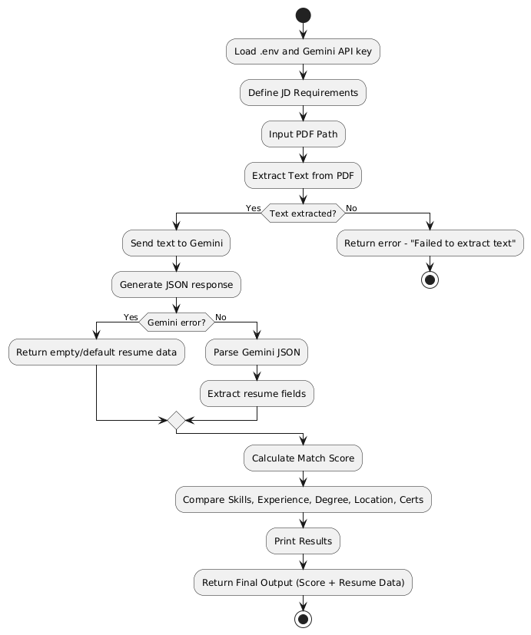
How it all works ?
Resume Screening Pipeline

Slide 4
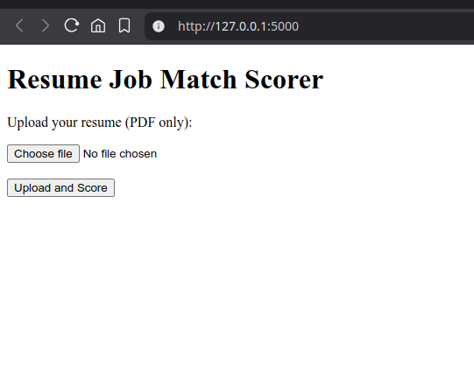
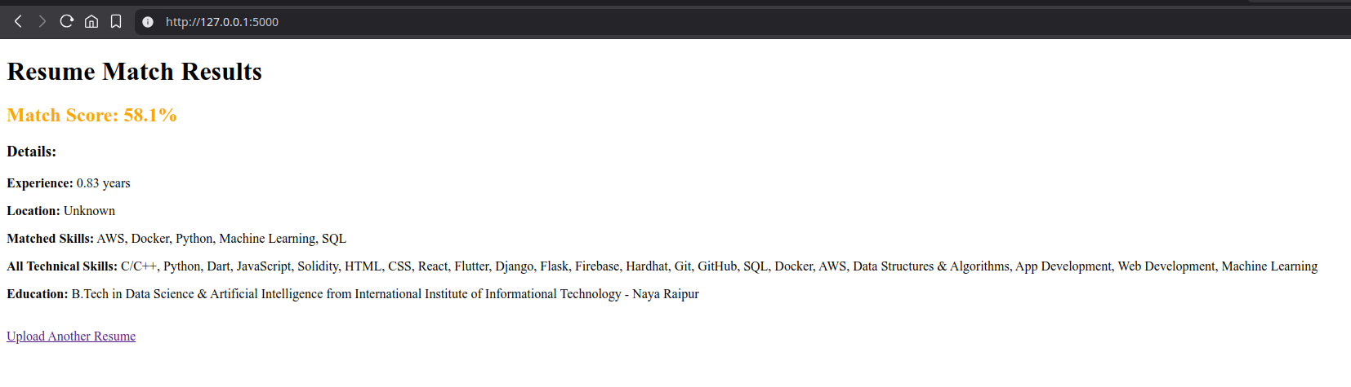
Resume Screening – In Action
Extract skills, experience, education using NLP
Match resume to job description
Gemini generates human-like recommendations
Use case: Accept/Reject suggestion + reason

Slide 5
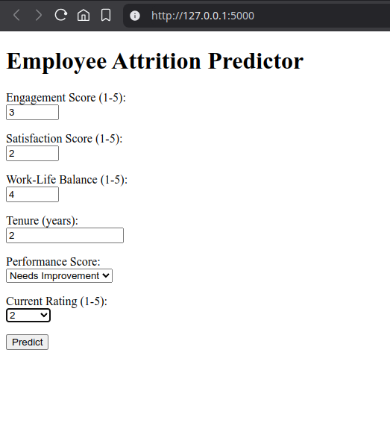
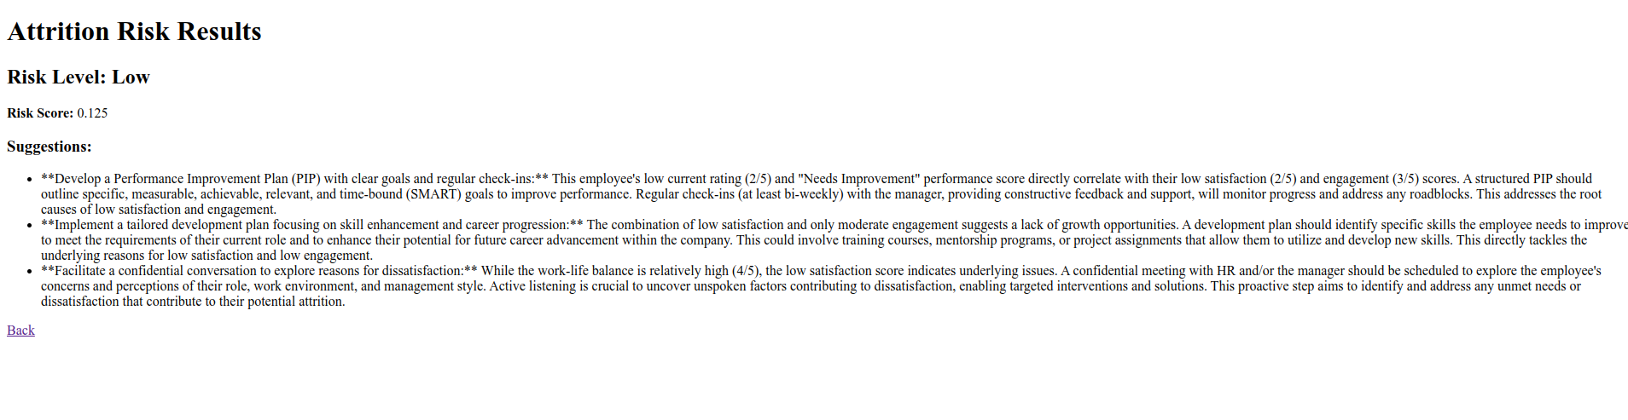
Attrition Prediction – In Action
Predict whether an employee is likely to leave
Models used: Random Forest, Gradient Boosting
Key features: Job satisfaction, overtime, department
AI gives retention strategies (from Gemini)

Slide 6
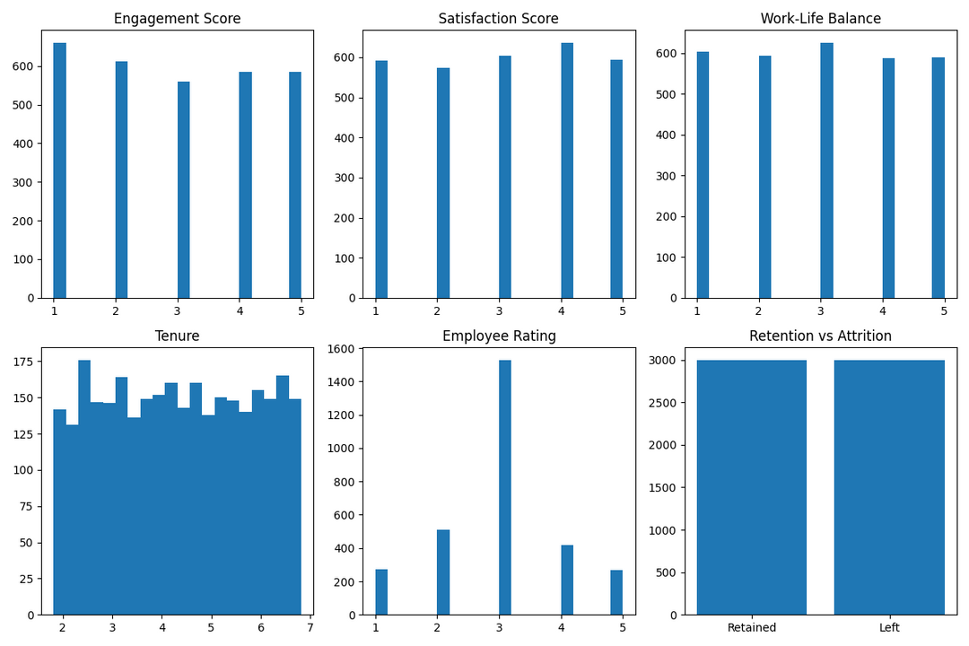
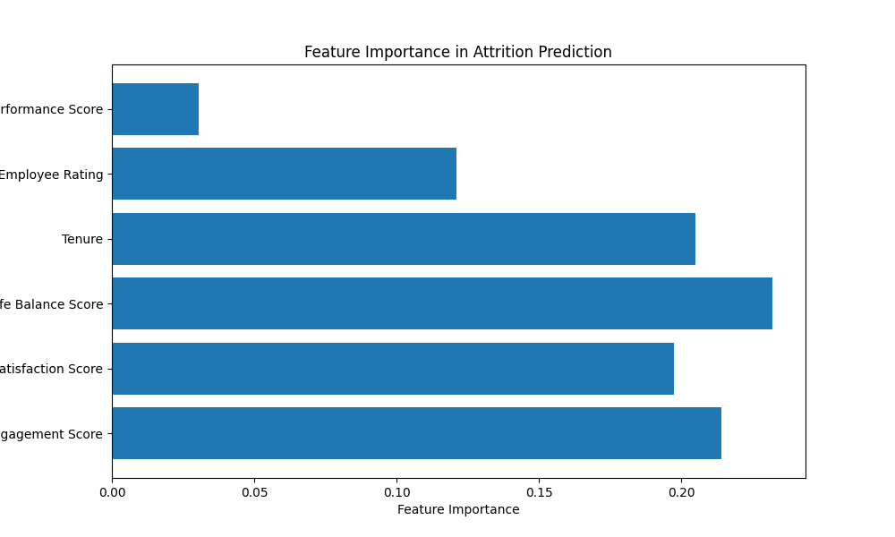
Data & Results

Slide 7
Thankyou
Api Endpoint: https://attrition-app.purpleplant-47c020aa.eastus.azurecontainerapps.io/predict
ashutoshj11100@gmail.com
Cont: 9129093900

